Slide 1



Project Win
Portal simulation

Slide 2


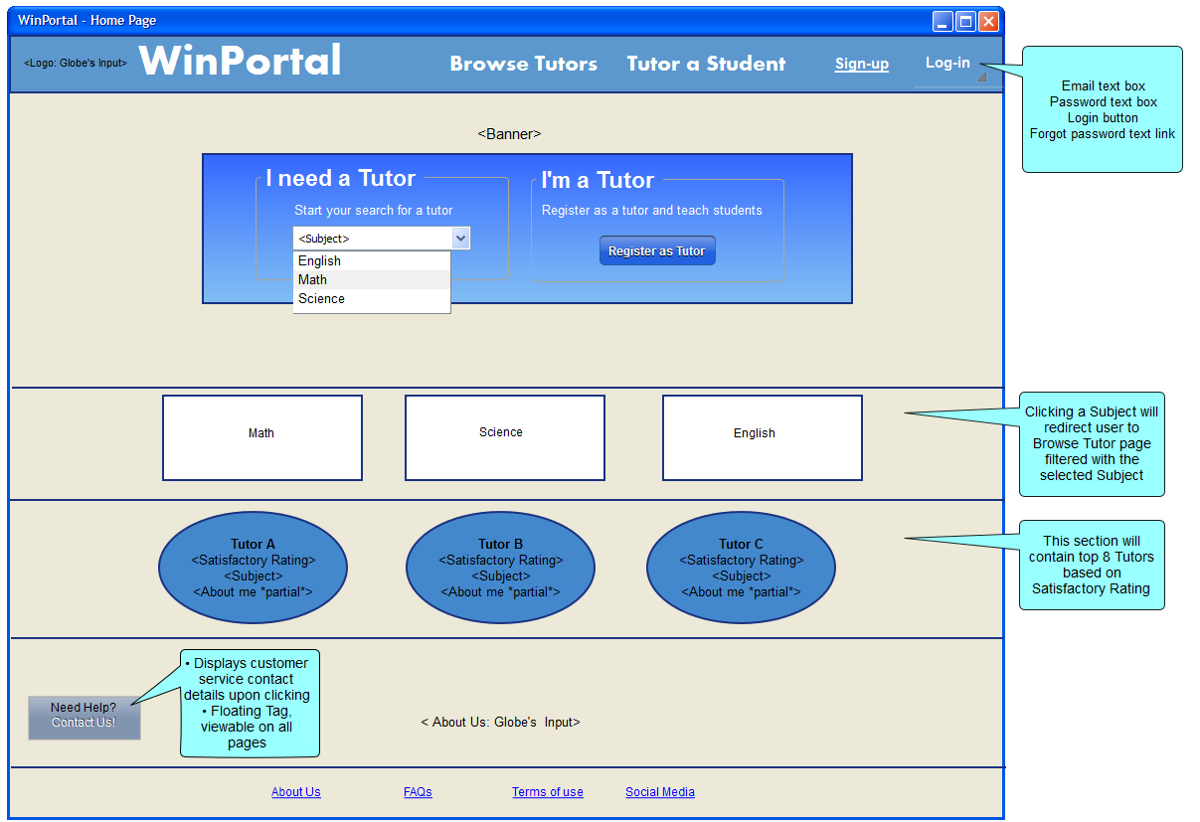



Home Page
1.) Click any Subject on the Subject combo box
to simulate
Student/Parent
flow.
2.) Click “Register as Tutor” button to simulate Tutor
flow.

Slide 3
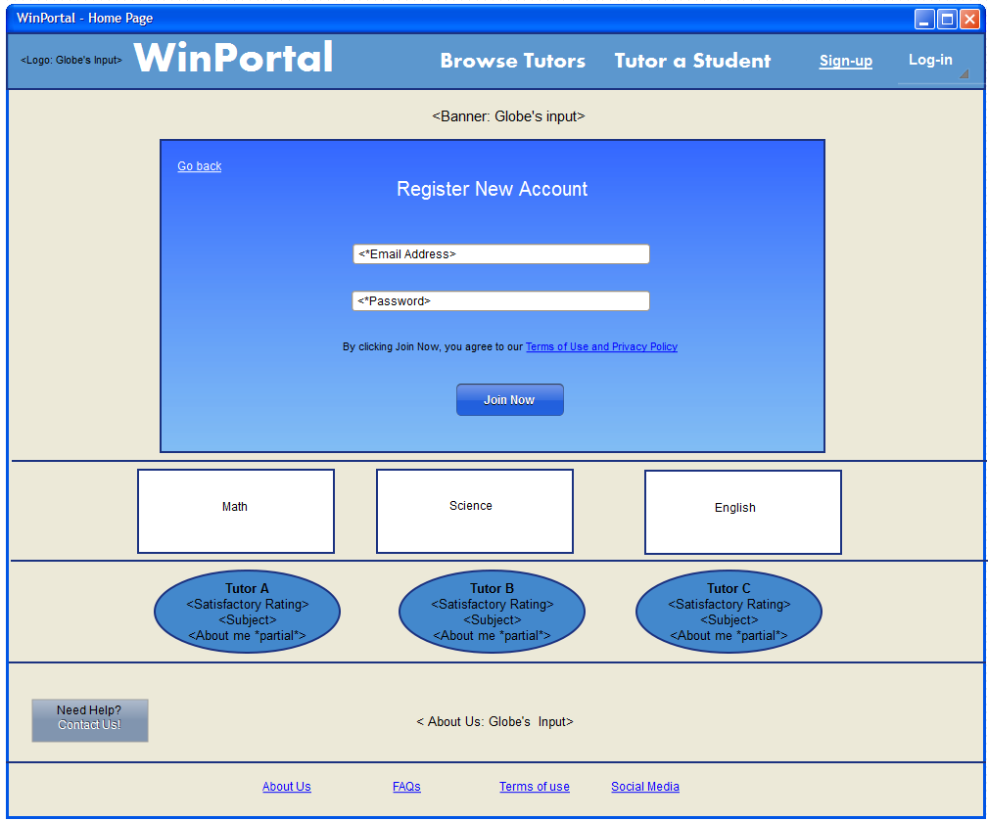

Home Page – Quick Sign-up (Parent/Student)
1.) After selecting a Subject, user will be redirected to Register New
Account section.
2.) Click “Join Now” button to proceed.

Slide 4
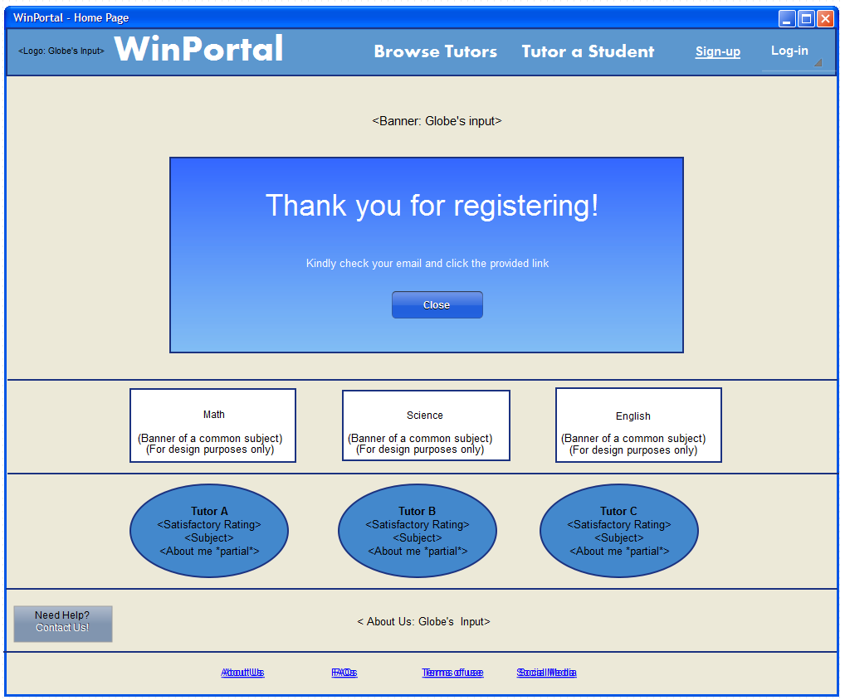
Home Page – Registration Done (Parent/Student)
1.) System will prompt the
user to check his/her email.
2.) Click HERE to view mail.

Slide 5
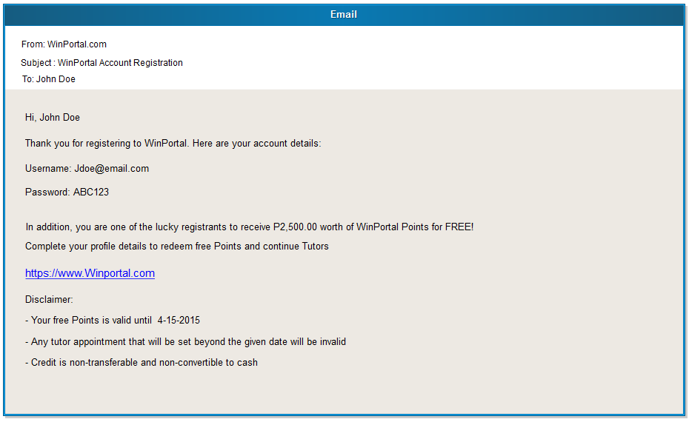
Email Content (Parent/Student)
1.) Sample Email content.
Email contains account
details, free credit (for pilot)
and disclaimers.
2.) Click the text link in the email to proceed.

Slide 6
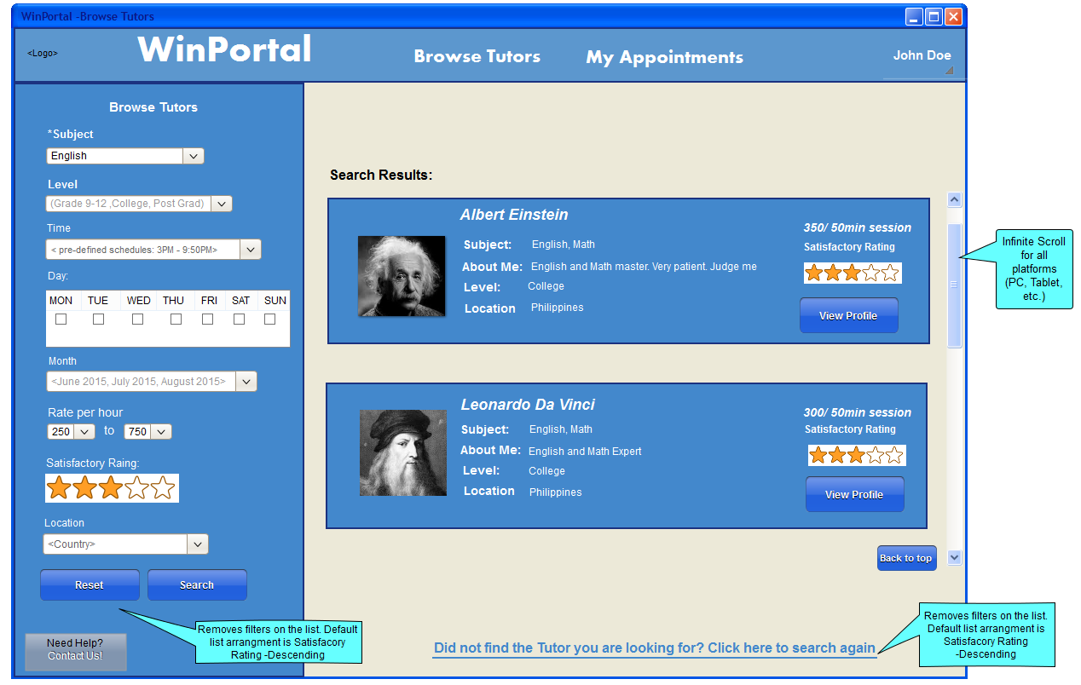

Browse Tutors – Search Results (Parent/Student)
1.) After logging-in, user will
be redirected to Browse Tutors page filtered with selected
Subject.
2.) Click View Profile button under Albert Einstein’s
Profile Summary.

Slide 7
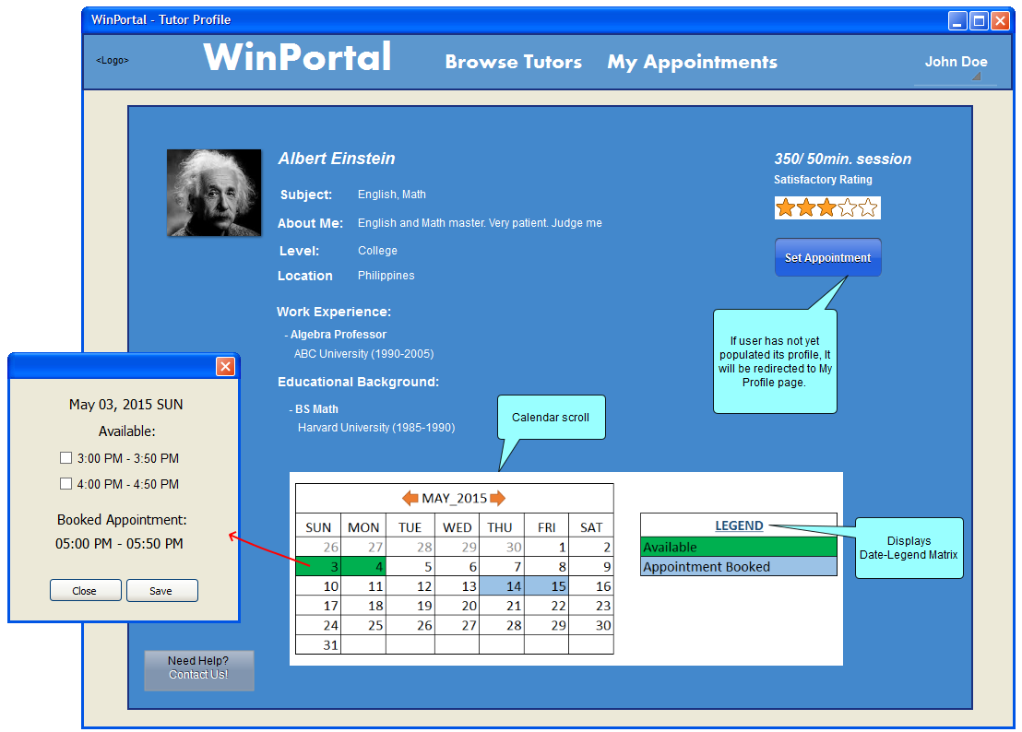

Tutor Profile – View Tutor’s Profile (Parent/Student)
1.) Tutor’s Profile page.
Contains more details about the Tutor.
2.) Click Set Appointment
Button to proceed.
3.) Click HERE to view
Date-Legend Matrix.

Slide 8
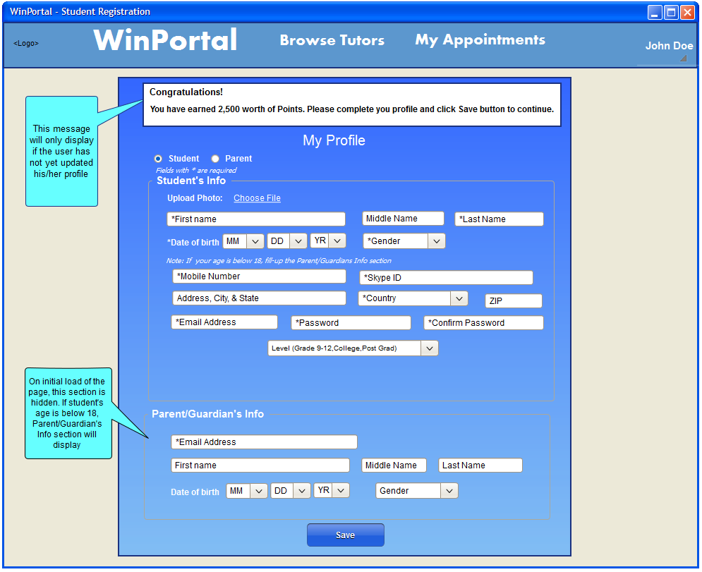

Profile – Full Registration (Student)
1.) If user has not yet populated
its profile, it will be redirected to My Profile page
2.) Click Save button to continue
3.) Click Parent radio button to view Full Registration (Parent)

Slide 9
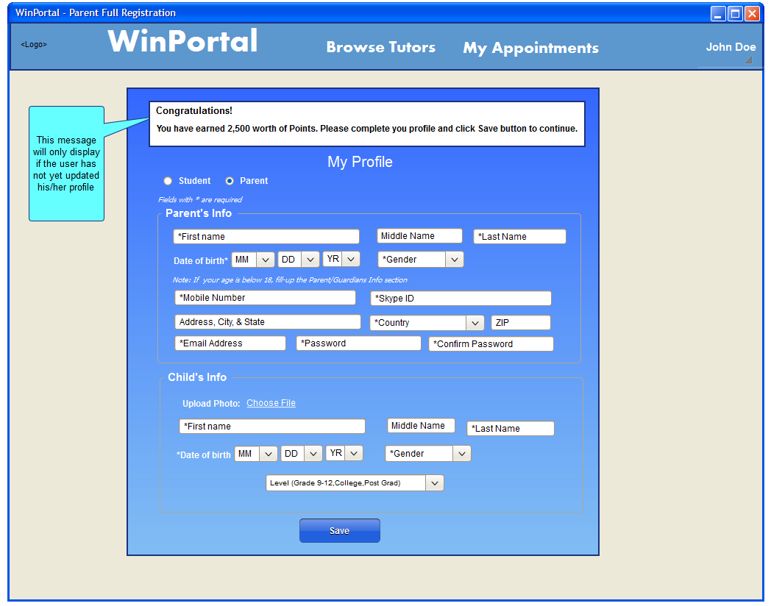
Profile – Full Registration (Parent)
1.) Click Save button to continue
2.) Click Student radio button to view
Full Registration (Student)

Slide 10
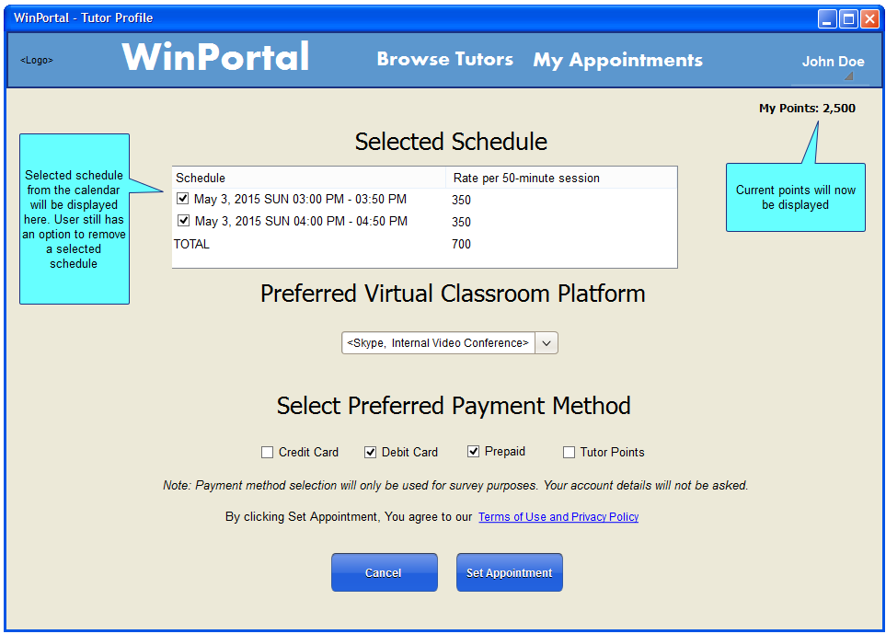

Tutor Profile – Set Appointment (Parent/Student)
1.) Click “Set Appointment” button to proceed.

Slide 11
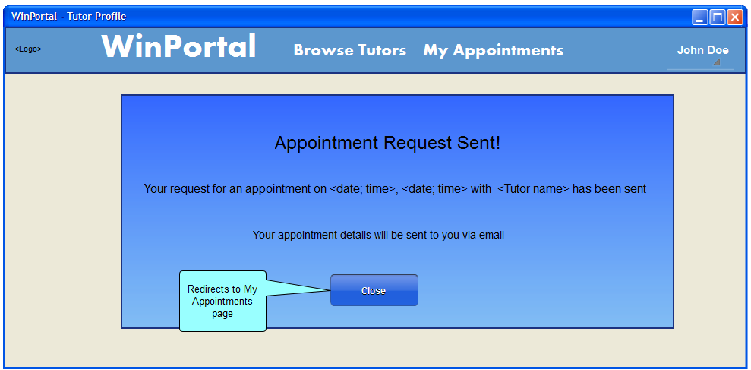


Tutor Profile – Appointment Request Sent (Parent/Student)
1.) After clicking Set Appointment button, a confirmation message will be displayed.
2.) Click WinPortal logo to go back to home page.
3.) Click My Appointments or Close button to go to
My Appointments page

Slide 12
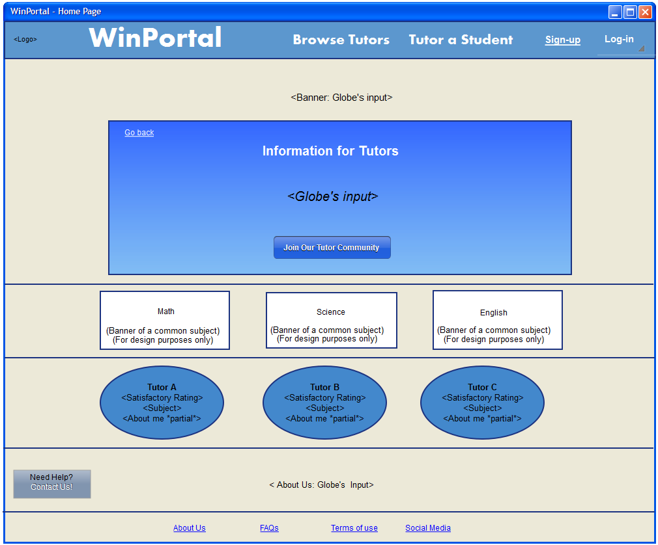

Tutor Registration - Information for Tutors
1.) After clicking “Register as Tutor”
Button, user will be redirected to
“Information for Tutors” page
2.) Click “Join Our Tutor Community” button to proceed

Slide 13
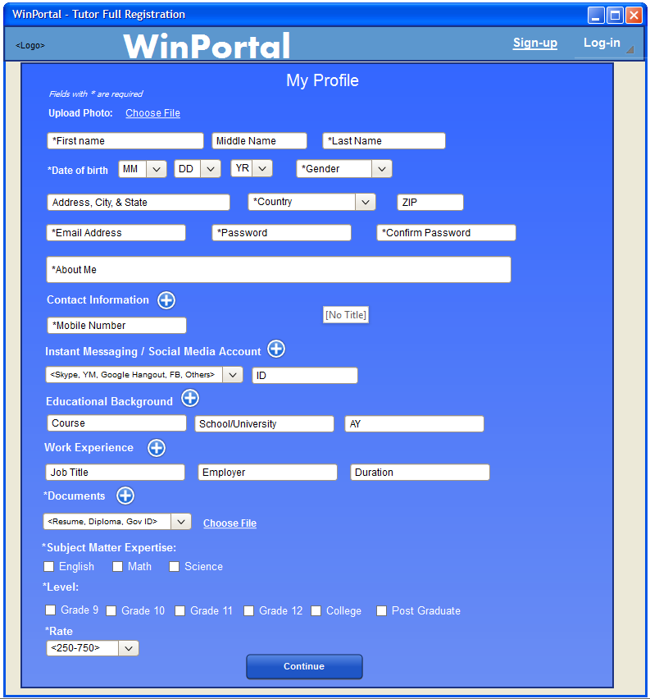
Profile – Full Registration (Tutor)
1.) After clicking “Join Our Tutor Community” button, User will be redirected to Tutor
registration page
2.) Click Continue button to proceed

Slide 14
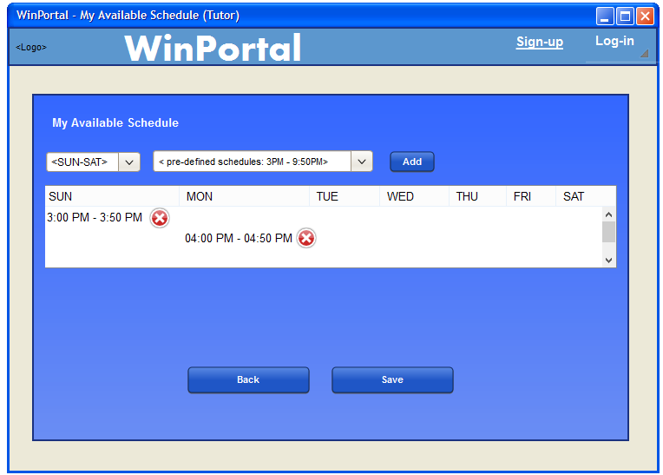

My Available Schedule (Tutor)
1.) After clicking Continue button, User will be redirected to My Available Schedule page.
2.) User will add his/her available schedule on the table. All selected day will be implemented throughout the pilot run.
3.) Click Save to Save button to proceed

Slide 15
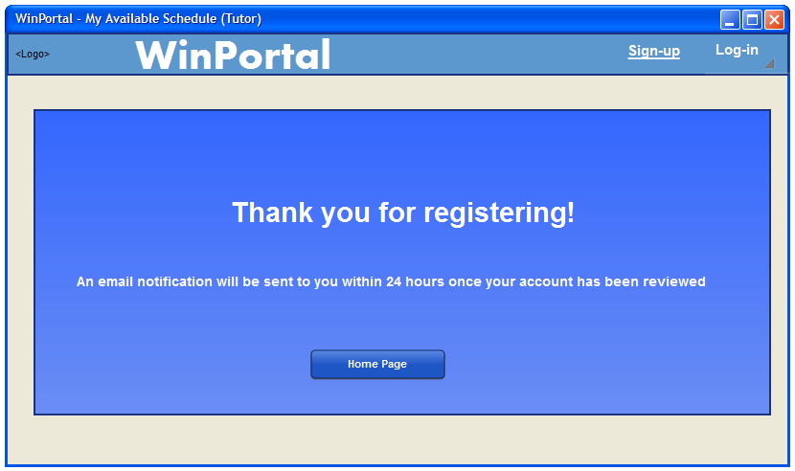

Home Page – Registration Done (Tutor)
1.) System will prompt the
user to check his/her email.
2.) Click HERE to view mail.

Slide 16
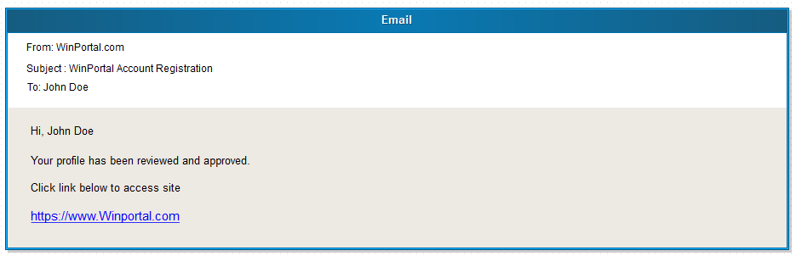
Email – Approval (Tutor)
1.) Sample Email content.
Email contains approval of Tutor’s profile registration.
2.) Click HERE to view
My Appointments (Tutor)

Slide 17
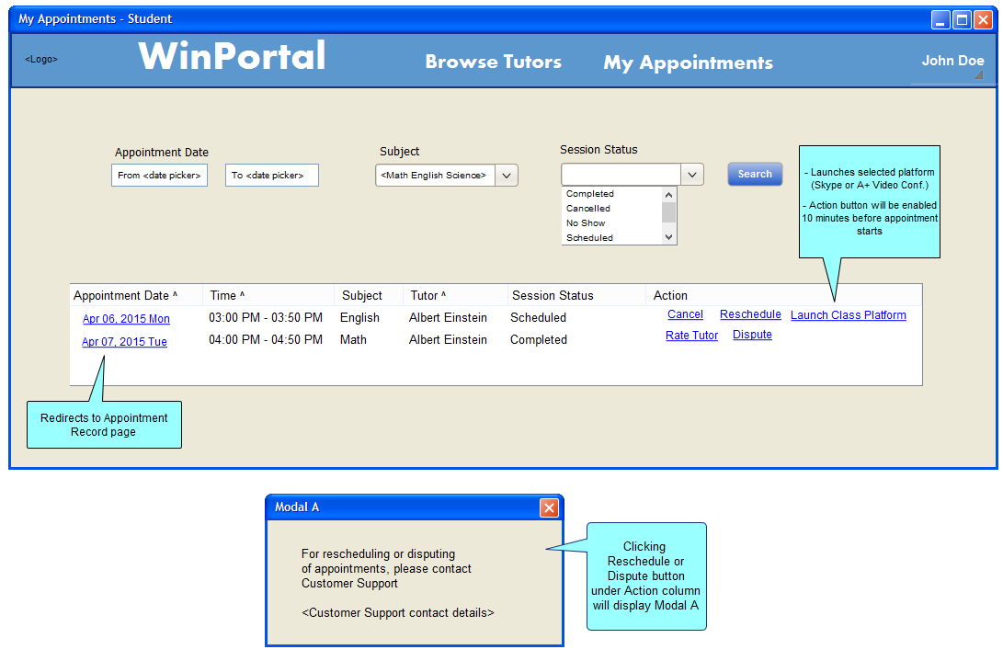

My Appointments – Appointment List (Student)
1.) After clicking
“My Appointments” button, You will be
redirected to
My Appointments page
2.) Click “Rate Tutor”
text link under
Action column
to proceed.
3.) Click “Cancel”
text link under
Action column
to proceed.

Slide 18
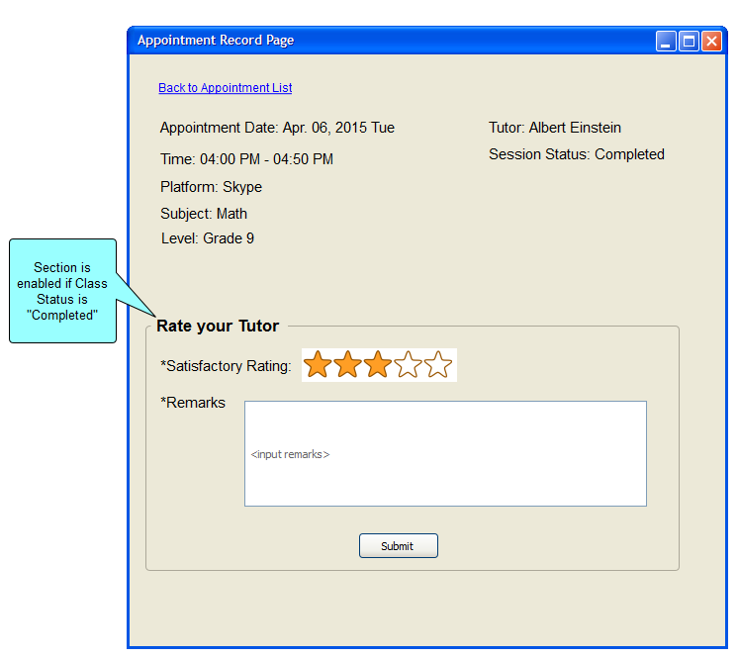
Appointment Record Page – Rate Tutor (Student)
1.) After clicking
“Rate Tutor” button, You will be redirected to
Appointment Record page.
2.) Click “Submit” button to go back My Appointments page.

Slide 19
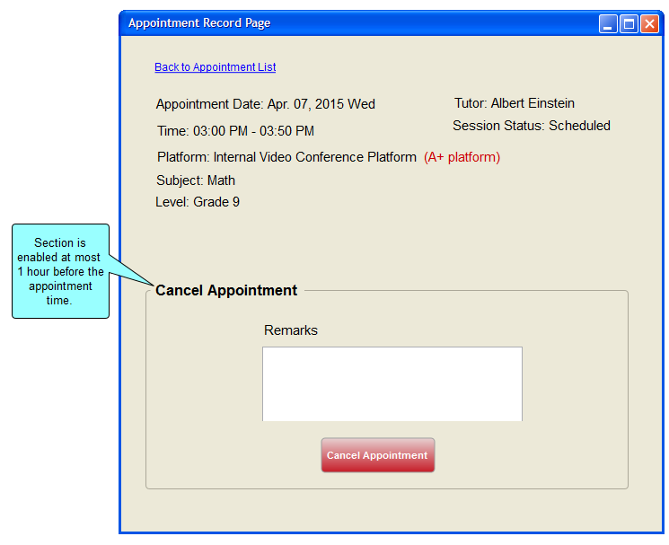

Appointment Record Page – Cancel Appointment (Student)
1.) After clicking
Cancel button, You will be
redirected to
Appointment Record page.
2.) Click “Cancel Appointment” button to go back
My Appointments page.

Slide 20
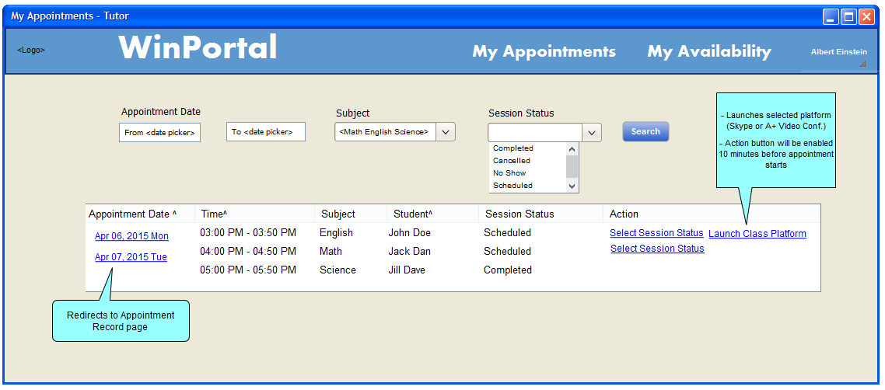
My Appointments – Appointment List (Tutor)
1.) Click “Select Class Status”
text link under
Action column
to proceed.

Slide 21
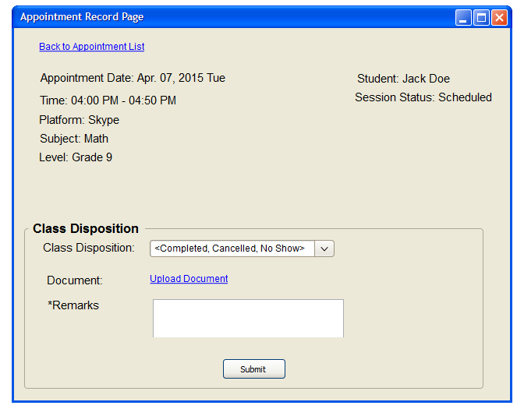

Appointment Record Page– Select Class Status (Tutor)
1.) After clicking
“Select Class Status” text link,
You will be redirected to
Appointment Record page.
2.) Click “Submit” button to go back My Appointments page.

Slide 22
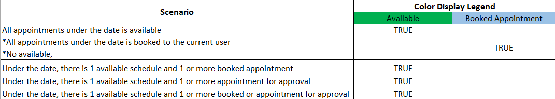
Date-Legend Matrix
1.) Click HERE to go back to
Tutor Profile

